Slide 1
Orthographic Projection Drawing
Technological Design
TDJ3M0 - Grade 11

Slide 2
Agenda
Orthographic Projection
6 Principle Views
Rules of Orthographic Projection
Principle Views
Glass Box
Line Types
Example – Orthographic Projection

Slide 3
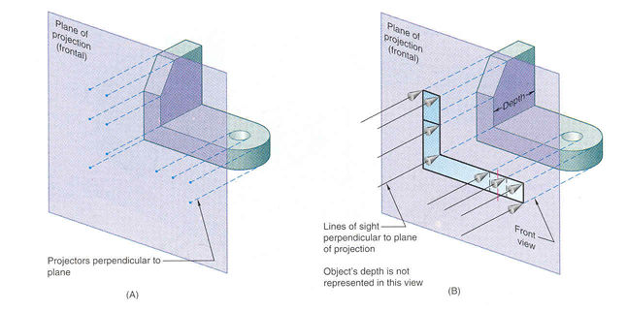
Orthographic Projection
Orthographic Projections are a collection of 2-D drawings that work together to give an accurate overall representation of an object.

Slide 4
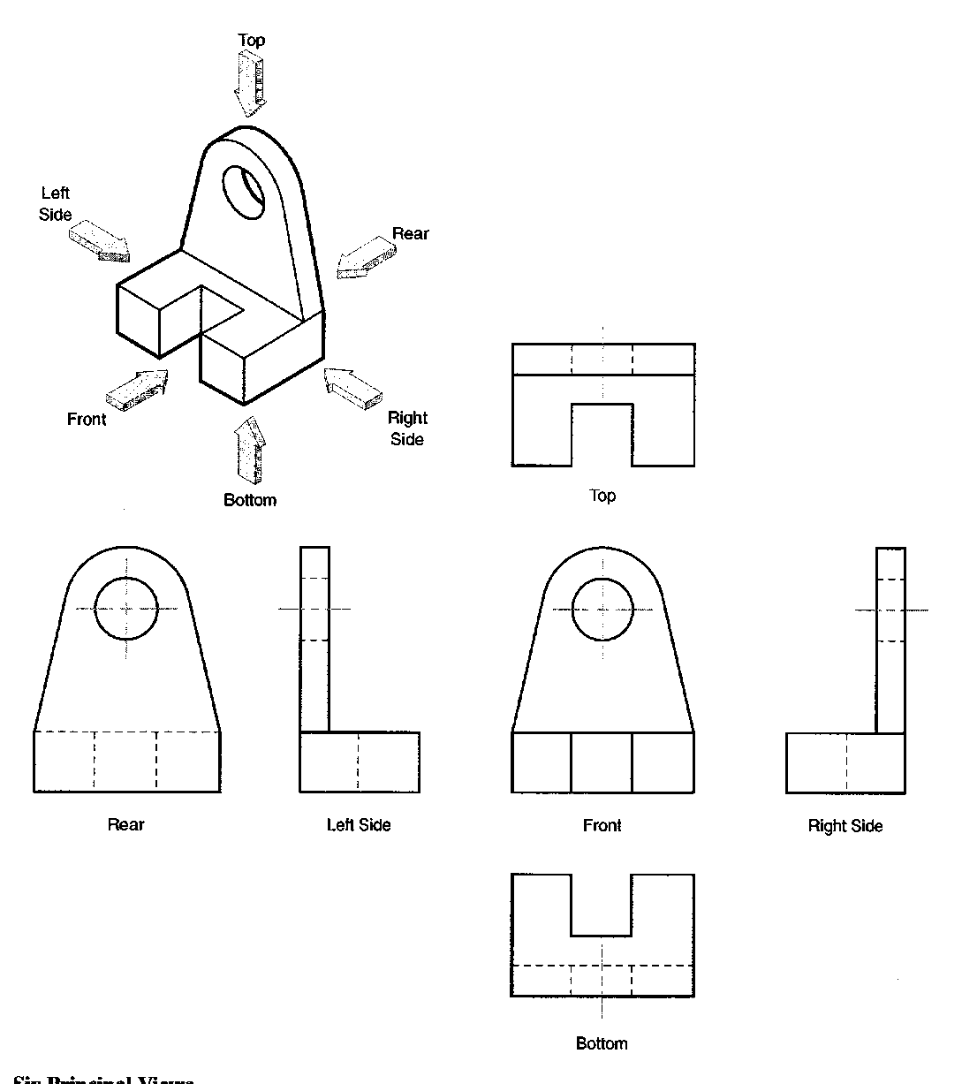
Six Principle Views
The 6 views of projection include:
FRONT
RIGHT SIDE
TOP
BOTTOM
LEFT SIDE
REAR

Slide 5
Rules of Orthographic Drawing
Pick a Front View that is most descriptive of object, normally the longest dimension is chosen as the width (or depth)
Most common combination of views is to use are Front, Top, and Side View

Slide 6
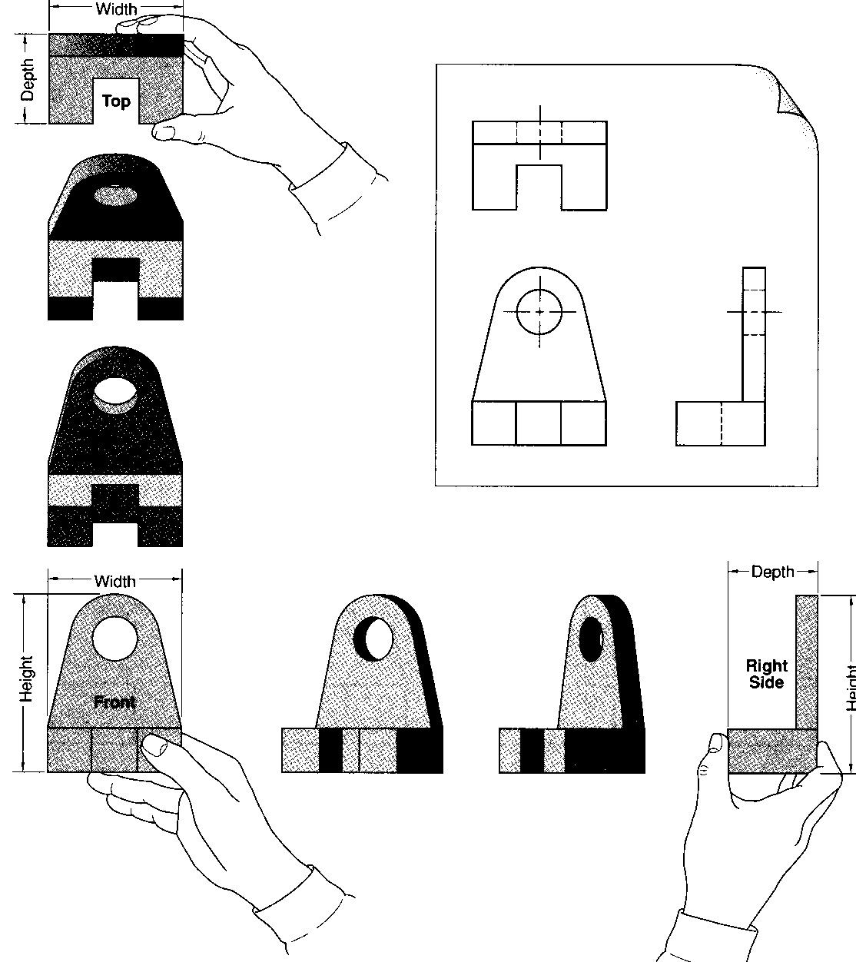
Principle Views
Front, Right Side and Top are views that simply represented by rotating the object

Slide 7
Glass Box
Most powerful technique to understand orthographic projections
Suspend the object with transparent strings inside a glass box
Freeze the view from each direction (each of the six sides of the box) and unfold the box

Slide 8
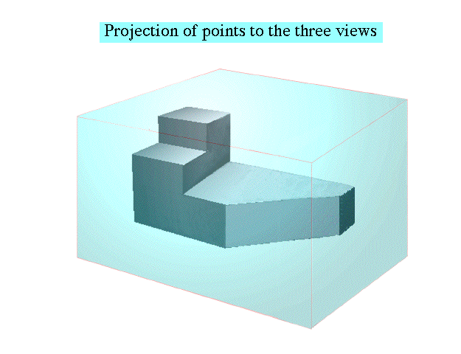
Glass Box

Slide 9
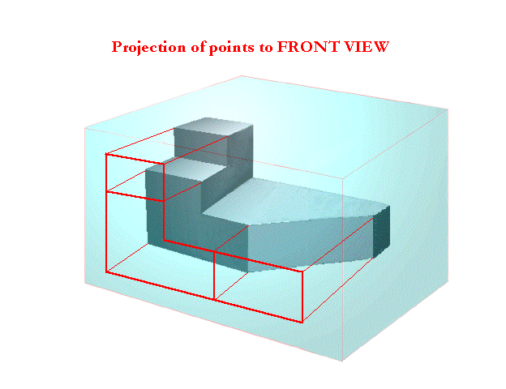
Glass Box

Slide 10
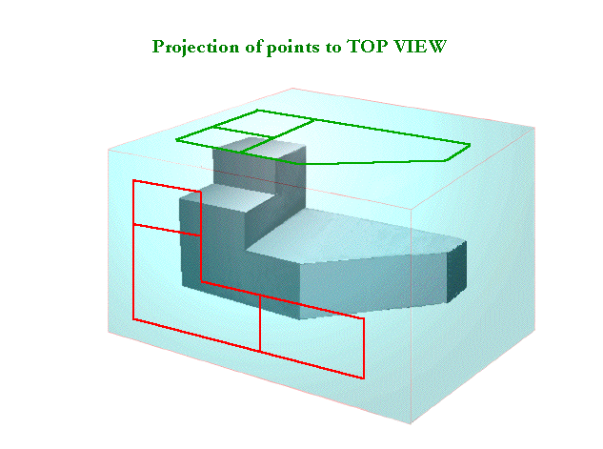
Glass Box

Slide 11
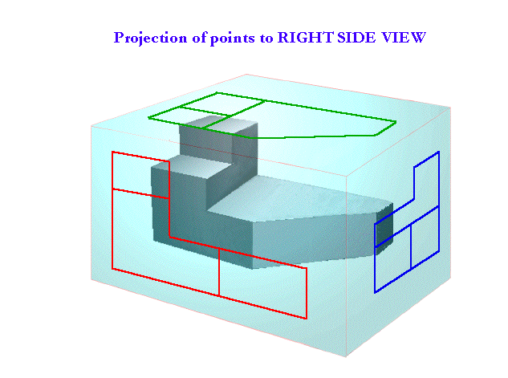
Glass Box

Slide 12
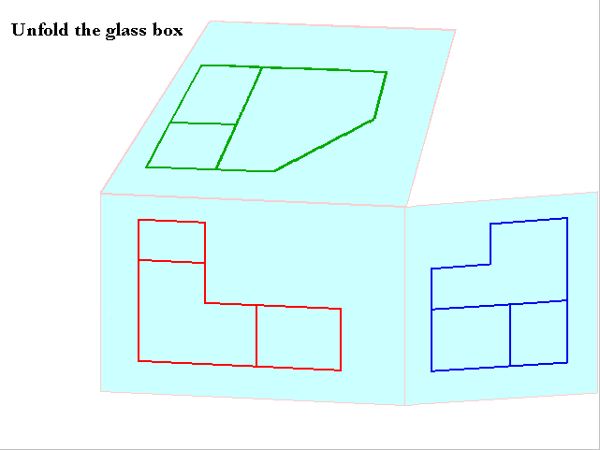
Glass Box

Slide 13
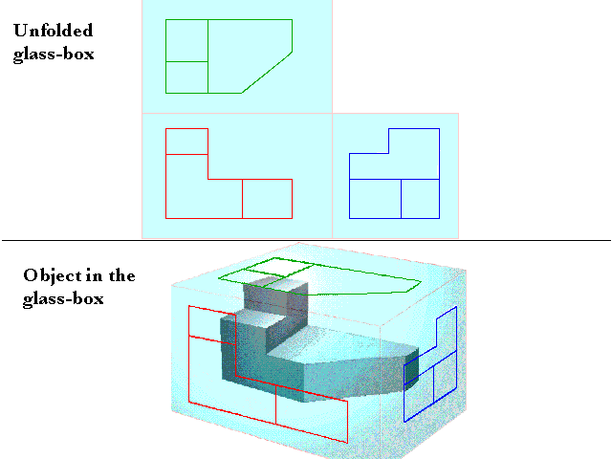
Glass Box

Slide 14
Front, Side and Top Views
Width
Top View
Depth
Right Side View
Front View
Height

Slide 15
Line Types
Visible Lines – used to represent features that are seen in the current view
Hidden Lines – used to represent features that cannot be seen in the current view
Centerlines – used to represent symmetry and to mark the center of circles and the axes of cylinders, and the axes of symmetrical parts, such as cylinders and bolts

Slide 16
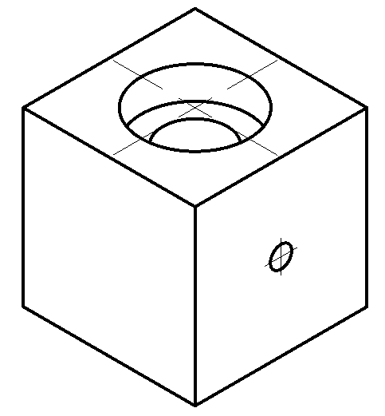
Example
1. Visible
2. Hidden
3. Center

Slide 17
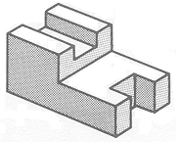
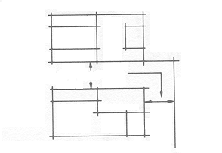

Drawing the Views
To complete an orthographic projection drawing follow these steps.
Step 2:
Space the top view 25-40 mm above the front view. Lightly construct the top view directly over the front view. Extend the lower side of the top view to intersect a vertical line drawn to the right of the front view.
25-40 mm
Step 1:
Lightly construct the front view.

Slide 18
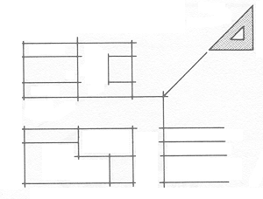
Drawing the Views
Step 3:
Project the features of the front view to the right of the vertical line. Draw a line at 45º from the point of intersection as shown.
The use of a 45º mitre line helps to project features from the top view to the side view.

Slide 19
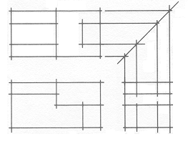
Drawing the Views
Step 4:
Where the horizontal projection lines of the top view intersect with the mitre line, draw vertical projection lines to the side view.

Slide 20
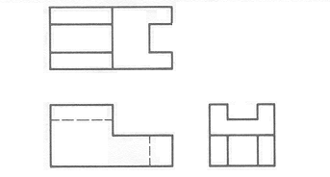
Drawing the Views
Step 5:
Erase all unnecessary lines. Complete the finished linework to complete the required orthographic views. Add the necessary information into the title block.

Slide 21
Spacing Orthographic Views
To determine the starting point of your drawing use the following criteria:
to find X:
Measure the horizontal distance between borders (HSA)
Subtract the total length of the views to be drawn (HSN)
Divide the result by 2
HSA – HSN = ? ÷ 2
to find Y:
Measure the vertical distance between borders (VSA)
Subtract the total height of the views to be drawn (VSN)
Divide the result by 2
VSA – VSN = ? ÷ 2

Slide 22
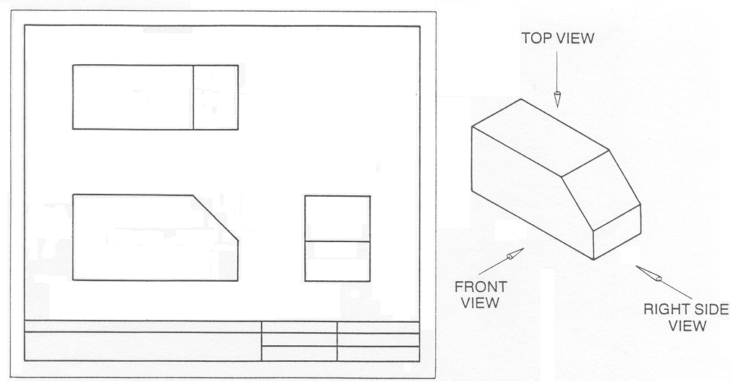
Spacing Orthographic Views
Distance between borders HSA 260
56
Length
120
Space
40
Width
38
120
38
31
(HSA) – (HSN) = ? ÷ 2 =
260 -
120
+ 40 + 38
198
= 62
÷ 2 = 31

